Slide 1
Neural Networks
Moin Mostakim

Slide 2
The First Neural Neural Networks
McCulloch and Pitts produced the first neural network in 1943
Many of the principles can still be seen in neural networks of today

Slide 3
The First Neural Neural Networks
X₁
2
X₂
2
Y
-1
X₃
The activation of a neuron is binary. That is, the neuron either fires (activation of one) or does not fire (activation of zero).

Slide 4
The First Neural Neural Networks
X₁
2
X₂
2
Y
-1
For the network shown here the activation function for unit Y is
f(y_in) = 1, if y_in >= θ else 0
where y_in is the total input signal received
θ is the threshold for Y
X₃

Slide 5
The First Neural Neural Networks
X₁
2
X₂
2
Y
-1
X₃
Neurons in a McCulloch-Pitts network are connected by directed, weighted paths

Slide 6
The First Neural Neural Networks
X₁
2
X₂
2
Y
-1
X₃
If the weight on a path is positive the path is excitatory, otherwise it is inhibitory

Slide 7
The First Neural Neural Networks
X₁
2
X₂
2
Y
-1
X₃
All excitatory connections into a particular neuron have the same weight, although different weighted connections can be input to different neurons

Slide 8
The First Neural Neural Networks
X₁
2
X₂
2
Y
-1
X₃
Each neuron has a fixed threshold. If the net input into the neuron is greater than the threshold, the neuron fires

Slide 9
The First Neural Neural Networks
X₁
2
X₂
2
Y
-1
X₃
The threshold is set such that any non-zero inhibitory input will prevent the neuron from firing

Slide 10
The First Neural Neural Networks
X₁
2
X₂
2
Y
-1
X₃
It takes one time step for a signal to pass over one connection.

Slide 11
The First Neural Neural Networks
X₁
1
Y
X₂
1
AND Function
Threshold(Y) = 2

Slide 12
The First Neural Neural Networks
X₁
2
Y
X₂
2
AND Function
OR Function
Threshold(Y) = 2

Slide 13
The First Neural Neural Networks
X₁
2
Y
X₂
-1
AND NOT Function
Threshold(Y) = 2

Slide 14
The First Neural Neural Networks
2
2
X₁
-1
Z₁
Y
X₂
-1
Z₂
2
2
XOR Function
X₁ XOR X₂ = (X₁ AND NOT X₂) OR (X₂ AND NOT X₁)

Slide 15
The First Neural Neural Networks
If we touch something cold we perceive heat
If we keep touching something cold we will perceive cold
If we touch something hot we will perceive heat

Slide 16
The First Neural Neural Networks
To model this we will assume that time is discrete
If cold is applied for one time step then heat will be perceived
If a cold stimulus is applied for two time steps then cold will be perceived
If heat is applied then we should perceive heat

Slide 17
The First Neural Neural Networks
2
Y₁
Hot
Heat
X₁
Z₁
2
-1
2
Cold
X₂
2
Z₂
1
Y₂
Cold
1

Slide 18
The First Neural Neural Networks
2
It takes time for the stimulus (applied at X₁ and X₂) to make its way to Y₁ and Y₂ where we perceive either heat or cold
Y₁
Hot
Heat
X₁
Z₁
2
-1
2
Cold
X₂
2
Z₂
1
Y₂
Cold
1
At t(0), we apply a stimulus to X₁ and X₂
At t(1) we can update Z₁, Z₂ and Y₁
At t(2) we can perceive a stimulus at Y₂
At t(2+n) the network is fully functional

Slide 19
The First Neural Neural Networks
We want the system to perceive cold if a cold stimulus is applied for two time steps
Y₂(t) = X₂(t – 2) AND X₂(t – 1)

Slide 20
The First Neural Neural Networks
We want the system to perceive heat if either a hot stimulus is applied or a cold stimulus is applied (for one time step) and then removed
Y₁(t) = [ X₁(t – 1) ] OR [ X₂(t – 3) AND NOT X₂(t – 2) ]

Slide 21
The First Neural Neural Networks
The network shows
Y₁(t) = X₁(t – 1) OR Z₁(t – 1)
Z₁(t – 1) = Z₂( t – 2) AND NOT X₂(t – 2)
Z₂(t – 2) = X₂(t – 3)
Substituting, we get
Y₁(t) = [ X₁(t – 1) ] OR [ X₂(t – 3) AND NOT X₂(t – 2) ]
which is the same as our original requirements

Slide 22
The First Neural Neural Networks
You can confirm that Y₂ works correctly
You can also check it works on the spreadsheet

Slide 23
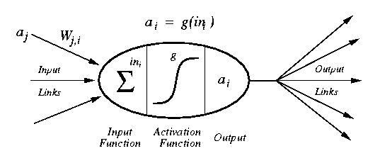
Modelling a Neuron
a_{j} :Activation value of unit j
w_{j,I} :Weight on the link from unit j to unit i
in_{I} :Weighted sum of inputs to unit i
a_{I} :Activation value of unit i
g :Activation function

Slide 24
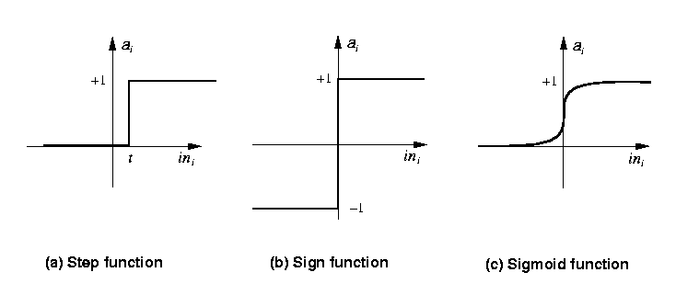
Activation Functions
Step_{t}(x) = 1 if x >= t, else 0
Sign(x) = +1 if x >= 0, else –1
Sigmoid(x) = 1/(1+e^{-x})
Identity Function

Slide 25
Simple Networks

Slide 26
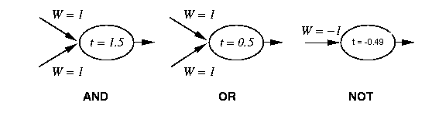
Simple Networks
-1
W = 1.5
x
t = 0.0
W = 1
y

Slide 27
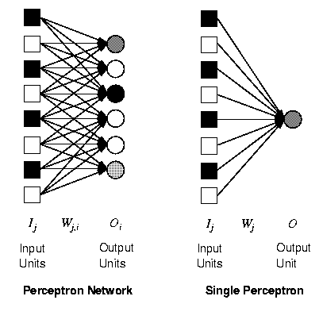
Perceptron
Synonym for Single-Layer, Feed-Forward Network
First Studied in the 50’s
Other networks were known about but the perceptron was the only one capable of learning and thus all research was concentrated in this area

Slide 28
Perceptron
A single weight only affects one output so we can restrict our investigations to a model as shown on the right
Notation can be simpler, i.e.

Slide 29
What can perceptrons represent?

Slide 30
What can perceptrons represent?
1,1
1,1
0,1
0,1
0,0
1,0
1,0
AND
0,0
XOR
Functions which can be separated in this way are called Linearly Separable
Only linearly Separable functions can be represented by a perceptron

Slide 31
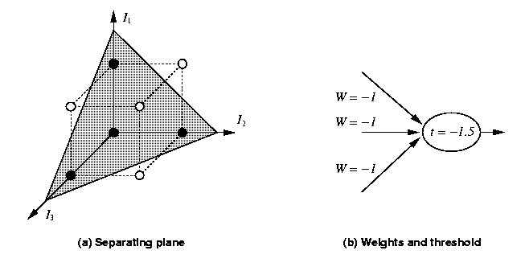
What can perceptrons represent?
Linear Separability is also possible in more than 3 dimensions – but it is harder to visualise

Slide 32
Training a perceptron
Aim

Slide 33
Training a perceptrons
-1
W = 0.3
x
t = 0.0
W = 0.5
W = -0.4
y

Slide 34
Learning
While epoch produces an error
Present network with next inputs from epoch
Err = T – O
If Err <> 0 then
W_{j} = W_{j} + LR * I_{j} * Err
End If
End While

Slide 35
Learning
While epoch produces an error
Present network with next inputs from epoch
Err = T – O
If Err <> 0 then
W_{j} = W_{j} + LR * I_{j} * Err
End If
End While
Epoch : Presentation of the entire training set to the neural network. In the case of the AND function an epoch consists of four sets of inputs being presented to the network (i.e. [0,0], [0,1], [1,0], [1,1])

Slide 36
Learning
While epoch produces an error
Present network with next inputs from epoch
Err = T – O
If Err <> 0 then
W_{j} = W_{j} + LR * I_{j} * Err
End If
End While
Training Value, T : When we are training a network we not only present it with the input but also with a value that we require the network to produce. For example, if we present the network with [1,1] for the AND function the training value will be 1

Slide 37
Learning
While epoch produces an error
Present network with next inputs from epoch
Err = T – O
If Err <> 0 then
W_{j} = W_{j} + LR * I_{j} * Err
End If
End While
Error, Err : The error value is the amount by which the value output by the network differs from the training value. For example, if we required the network to output 0 and it output a 1, then Err = -1

Slide 38
Learning
While epoch produces an error
Present network with next inputs from epoch
Err = T – O
If Err <> 0 then
W_{j} = W_{j} + LR * I_{j} * Err
End If
End While
Output from Neuron, O : The output value from the neuron
Ij : Inputs being presented to the neuron
Wj : Weight from input neuron (I_{j}) to the output neuron
LR : The learning rate. This dictates how quickly the network converges. It is set by a matter of experimentation. It is typically 0.1

Slide 39
Learning
I₁
1,1
After First Epoch
0,1
Note
I₁ point = W₀/W₁
I₂ point = W₀/W₂
0,0
1,0
I₂
I₁
1,1
0,1
At Convergence
0,0
1,0
I₂

